Slide 1
Semantic Projection
and golden standard ratings

Slide 2
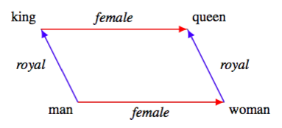
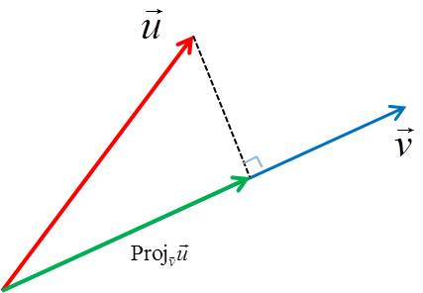
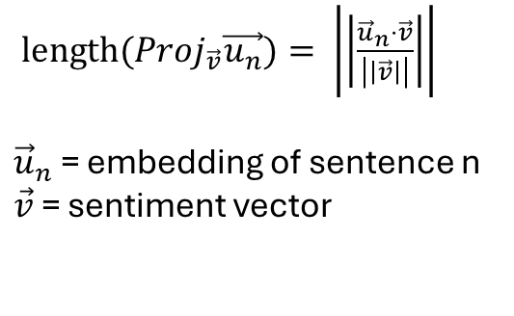
If a given direction in embedding space linearly encodes a concept.
Then the projected vector onto that direction describes how strongly the concept is represented.
And is easily computable with linear algebra, given that we can find the concept vector:
$length(Proj_{\vec{v}}\vec{u_{n}})= \left|\left|\frac{{\vec{u}}_{n}⋅\vec{v}}{\left|\left|\vec{v}\right|\right|}\right|\right|$
${\vec{u}}_{n}$ = embedding of sentence n
$\vec{v}$ = sentiment vector

Slide 3




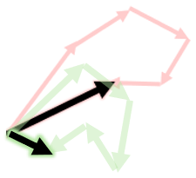






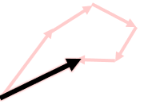
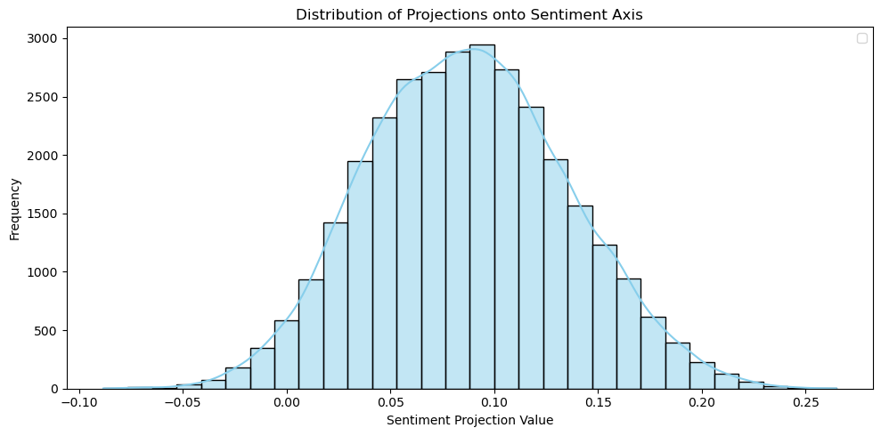

Positive corpus to mean Positive Vector
Difference as Concept Vector
Sentence projection onto Concept Vector
Define a Concept Corpus
This is a 7/10
Negative corpus to mean Negative Vector
Distribution of projection on Concept Vector
Embedded Unlabeled Corpus
Corpus of Interest
Embed Corpus of Interest

Slide 4

How do we attempt to validate this?
Avg. 5.67
Correlation
5.32
5
5
7
“Of course, I'm coming later”

Slide 5
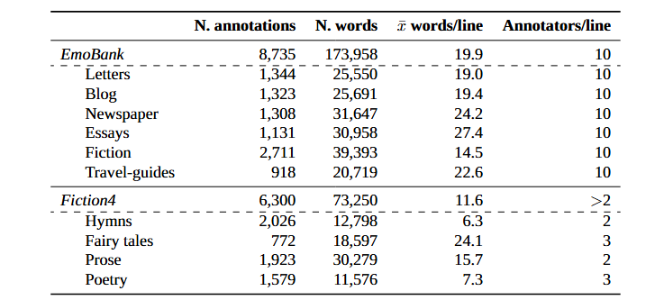
Data:
English
Overfitting sanity check on 10 annotators
Danish
Multilingual
English

Slide 6
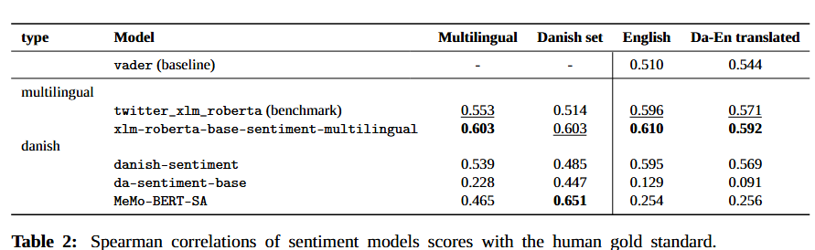
Current benchmark:

Slide 7
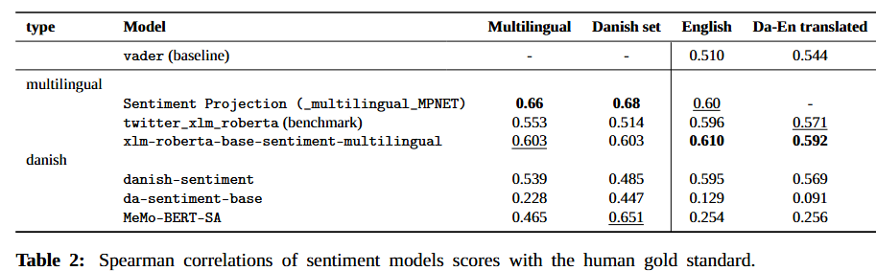
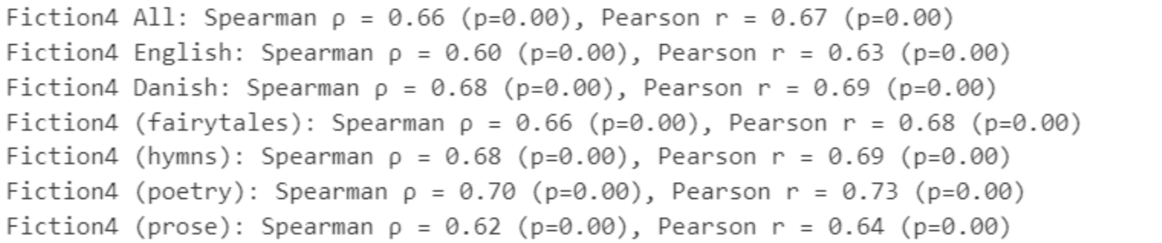
Current with results:

Slide 8
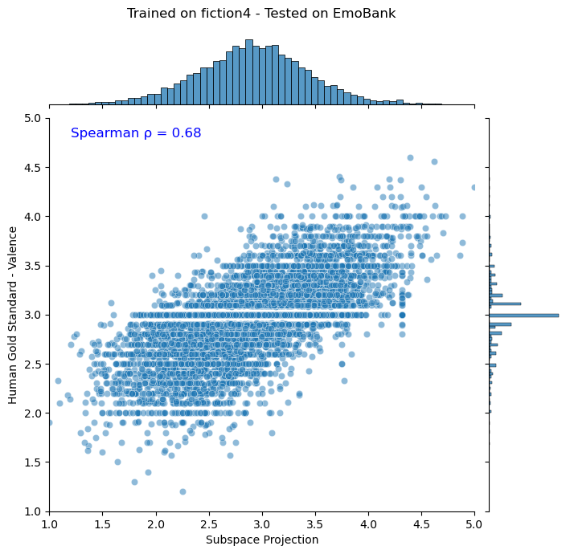
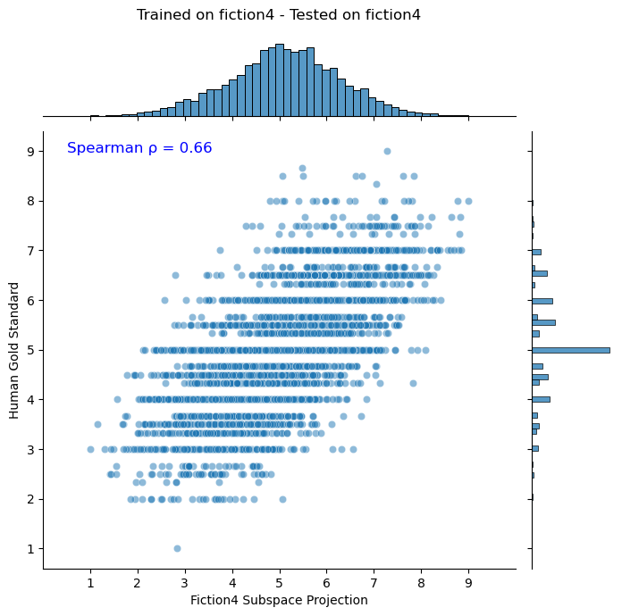

Slide 9
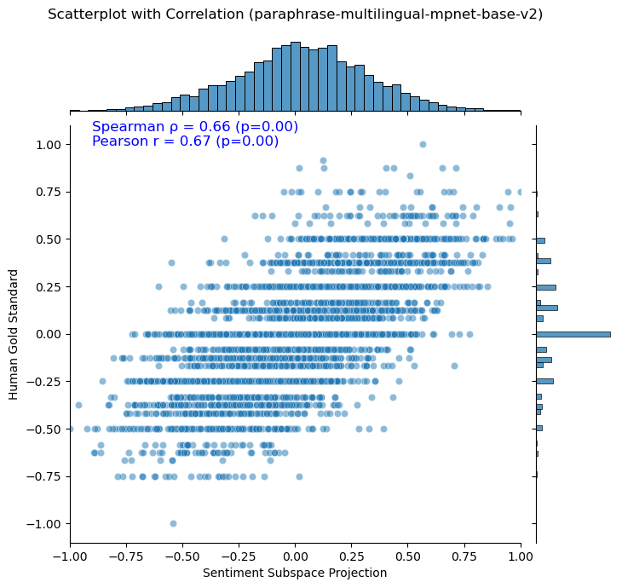

Slide 10
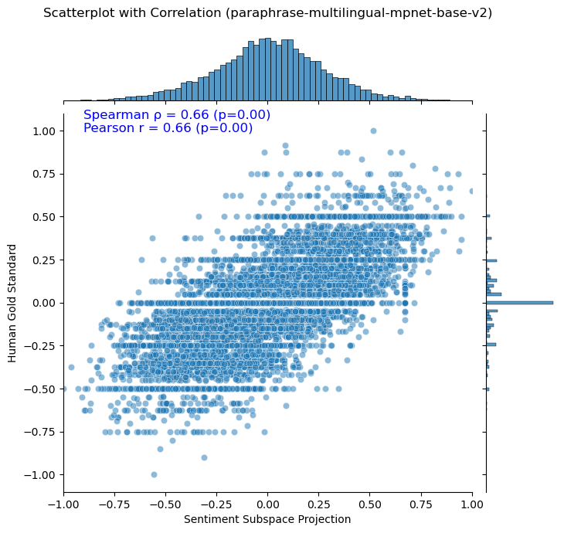
Both datasets

Slide 11
What’s next?
More defined concept vectors
Framework for fitting vectors into other latent spaces quickly.
Geometry of direction throughout linear transformation of layers.
Non-centroid based vector definition (e.g. logistic regression)
How few samples are needed? What workflow can be used to systematise this?

Slide 12
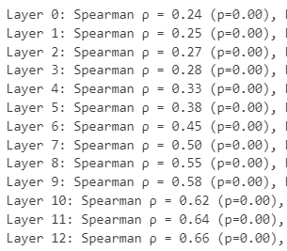
Development through layers:
Syntactic elements might be better represented in earlier layers.
Sentiment is mostly present in final representation.

Slide 13
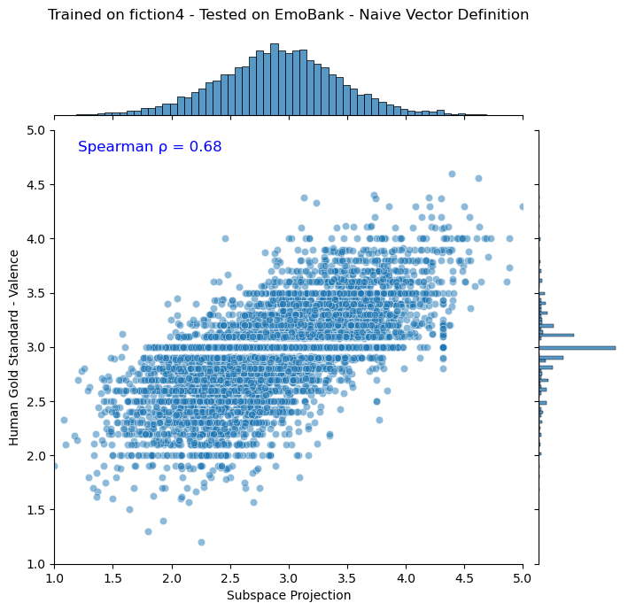
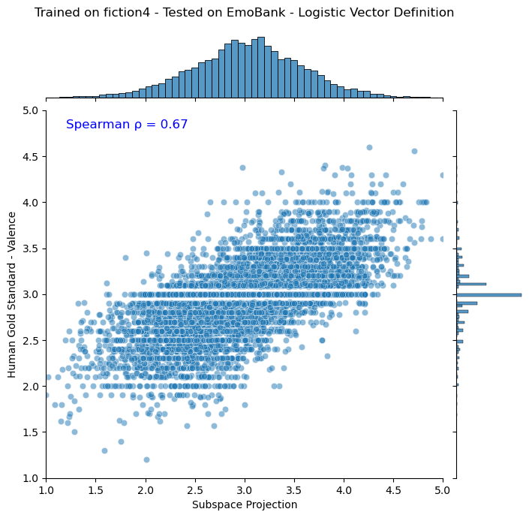
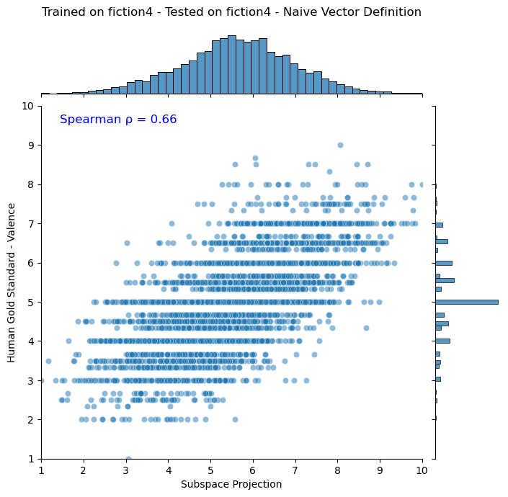
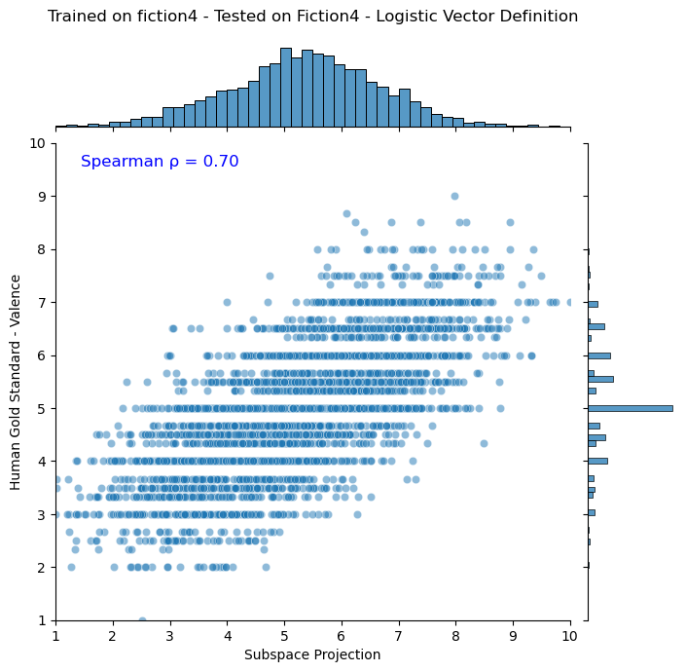
Centroids
Logistic regression
Fiction4 -> EmoBank
Fiction4 -> Fiction4

Slide 14
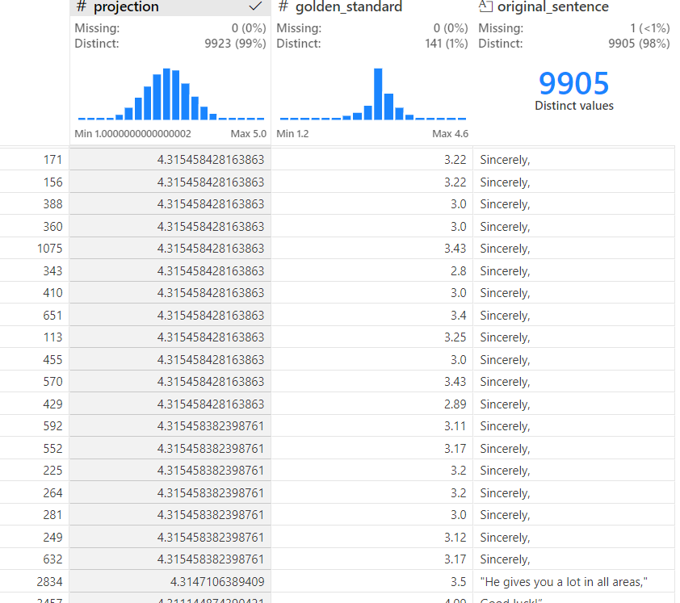
Extra: human annotators aren’t consistent

Slide 15
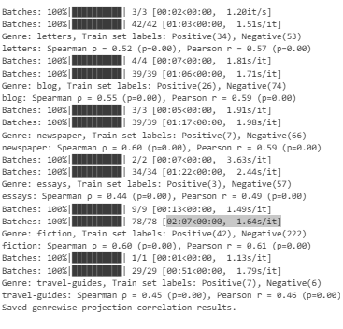

Slide 16
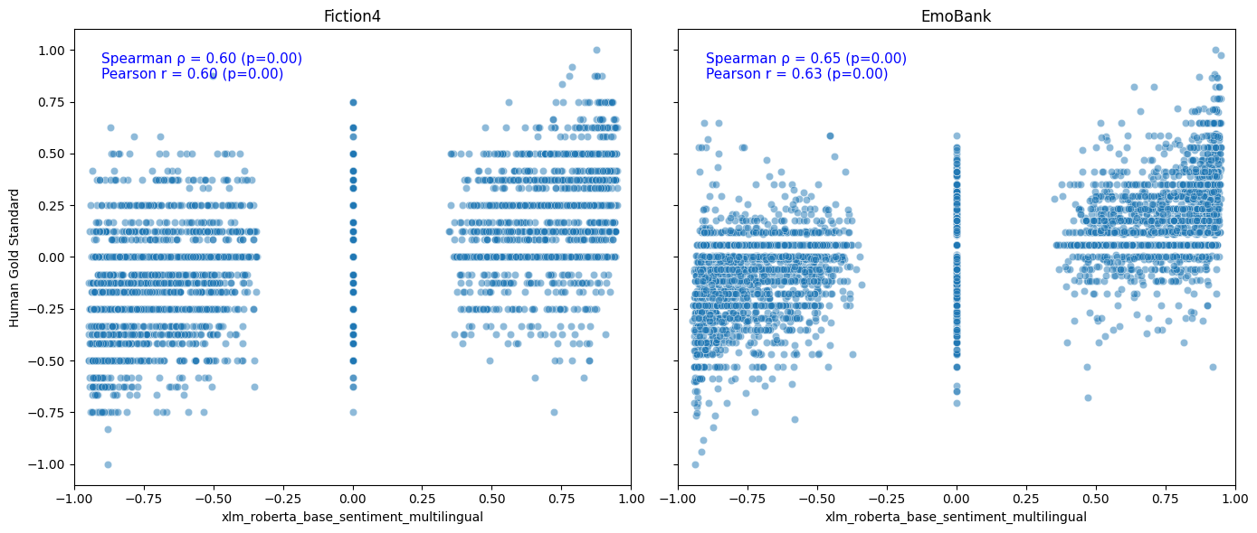
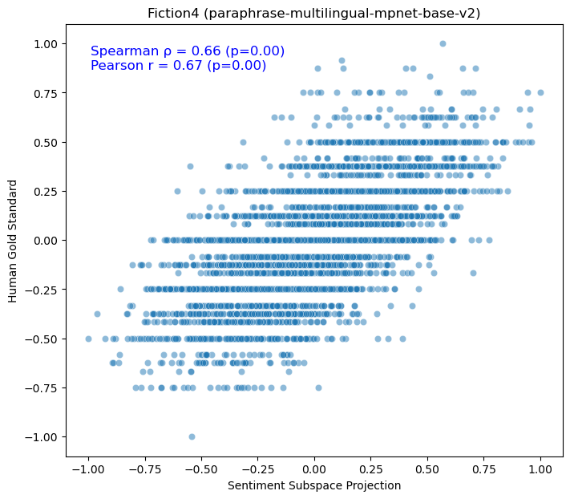
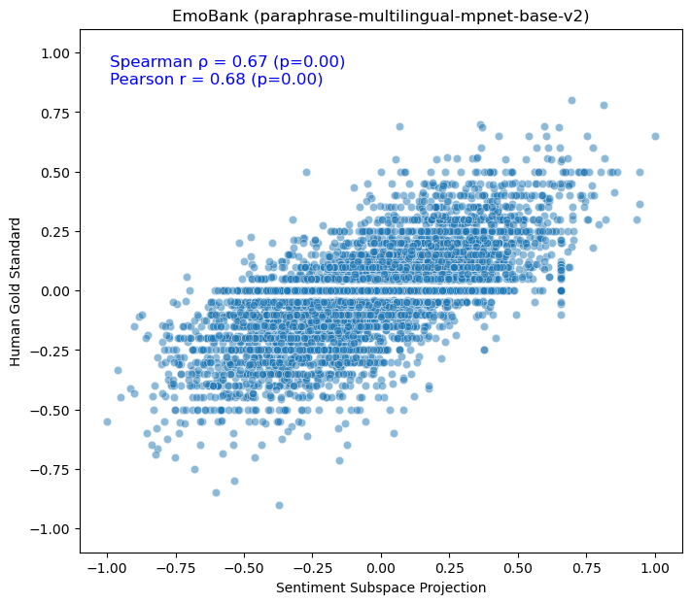
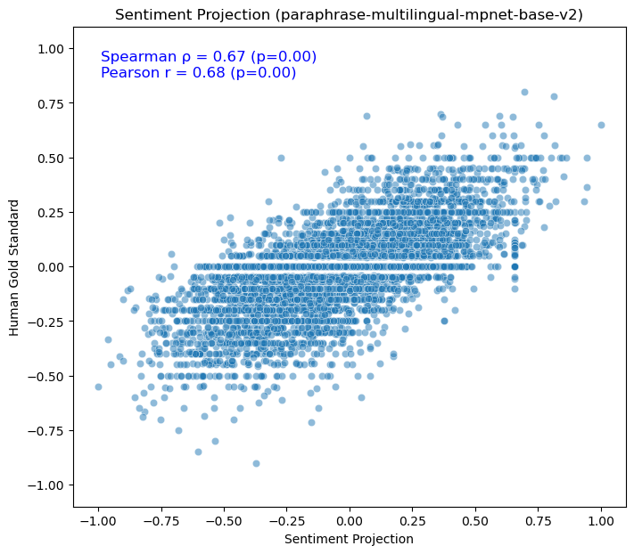
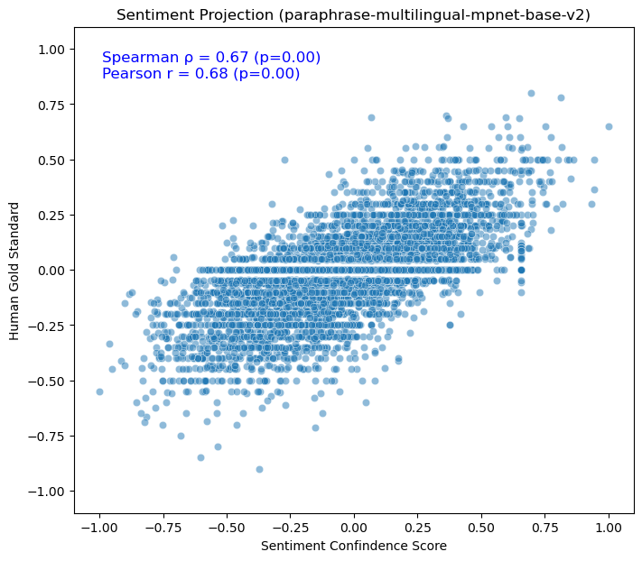


Slide 17
Fiction4 Sentiment Predictions
Continuous Prediction Space
Noncontinuous Prediction Space

Slide 18
Sentiment Projection
Sentiment Prediction Model
Human Ratings
Continuous Scores
+ Granularity
+ Moderate Scores
+ Human Similarity
Noncontinuous Scores
Extreme Scores
Tri-modal Distribution
Model Prediction
Model Prediction

Slide 19
Human Ratings

Slide 20
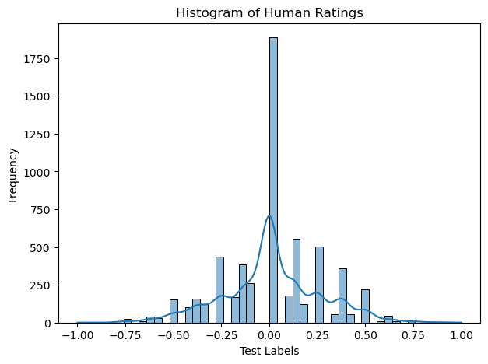
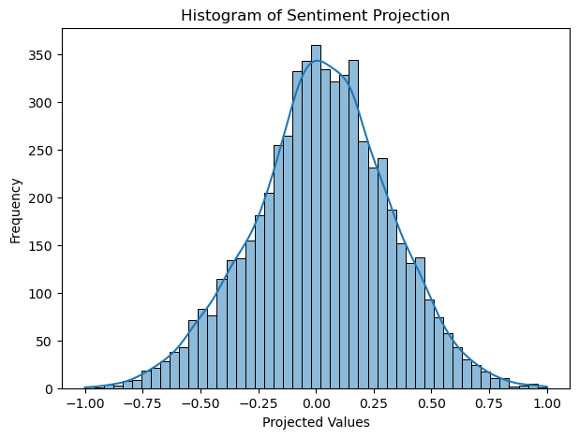
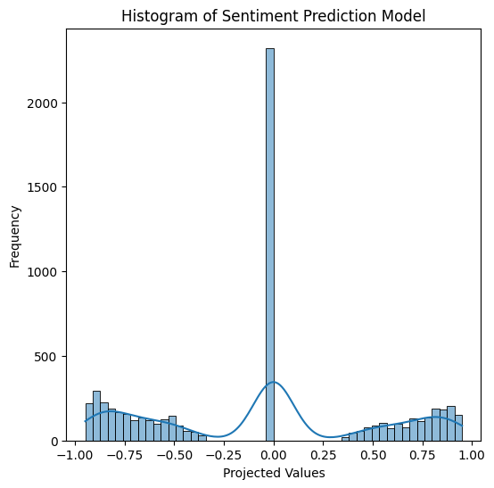
Human Ratings
Sentiment Projection
Sentiment Prediction Model
Frequency
Human Rating
Model Prediction
Model Prediction

Slide 21
